Slide 1
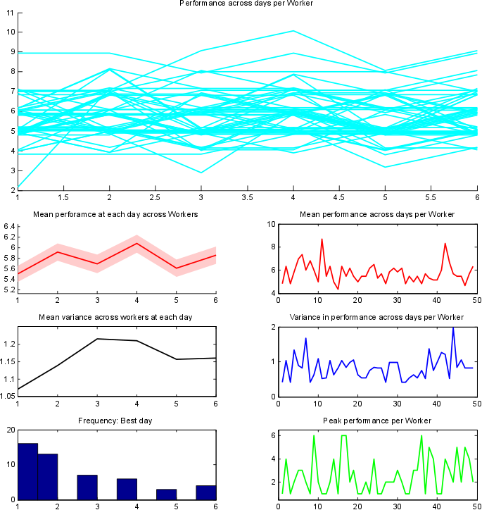
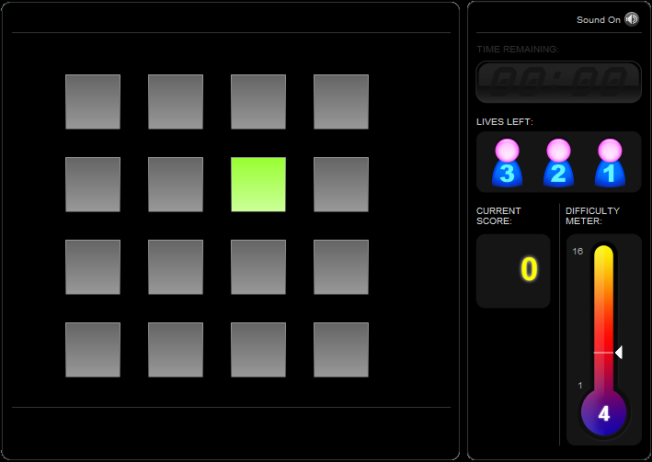
Spatial Span
Repeat the sequence by clicking on the squares in the same order in which they flashed.
Performance = max score

Slide 2
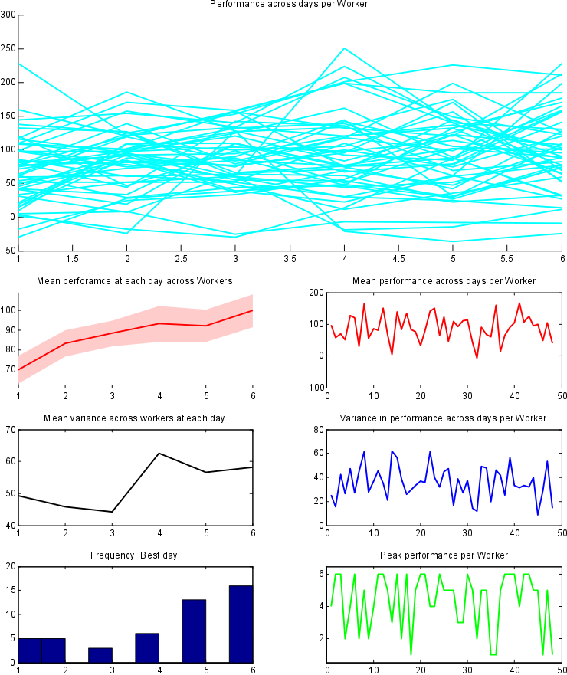
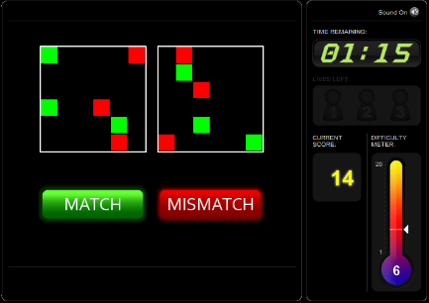
Spatial rotation
Indicate whether or not the grids are identical (rotated by multiple of 90).
Performance = correct (sum of all squares) – incorrect (sum of all squares)
Notes:
solving as many problems as possible within 90 seconds
If the response is correct, the total score increases by the number of squares in the grid and subsequent trials have more squares. If the response is incorrect the total score decreases by the number of squares in the grid and subsequent trials have fewer squares.

Slide 3
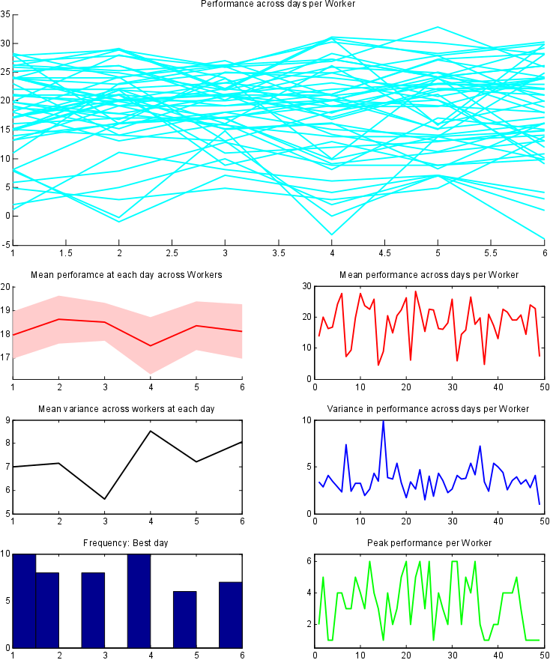
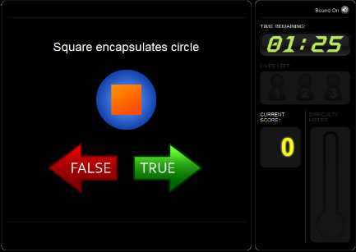
Verbal reasoning
Indicate whether the sentence correctly describes the pair of objects displayed on the screen.
Performance = max correct

